Slide 1

SPOTIFY MUSIC DATA AND PATRICKS MOOD
Veena and patrick

Slide 2
Tableau
Dataset
https://www.kaggle.com/edumucelli/spotifys-worldwide-daily-song-ranking

Slide 3
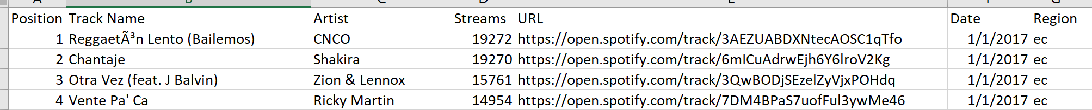
Tableau Data
Over 1 million rows of data
Single source data
Filtered only 2017 daily streams
53 Countries

Slide 4
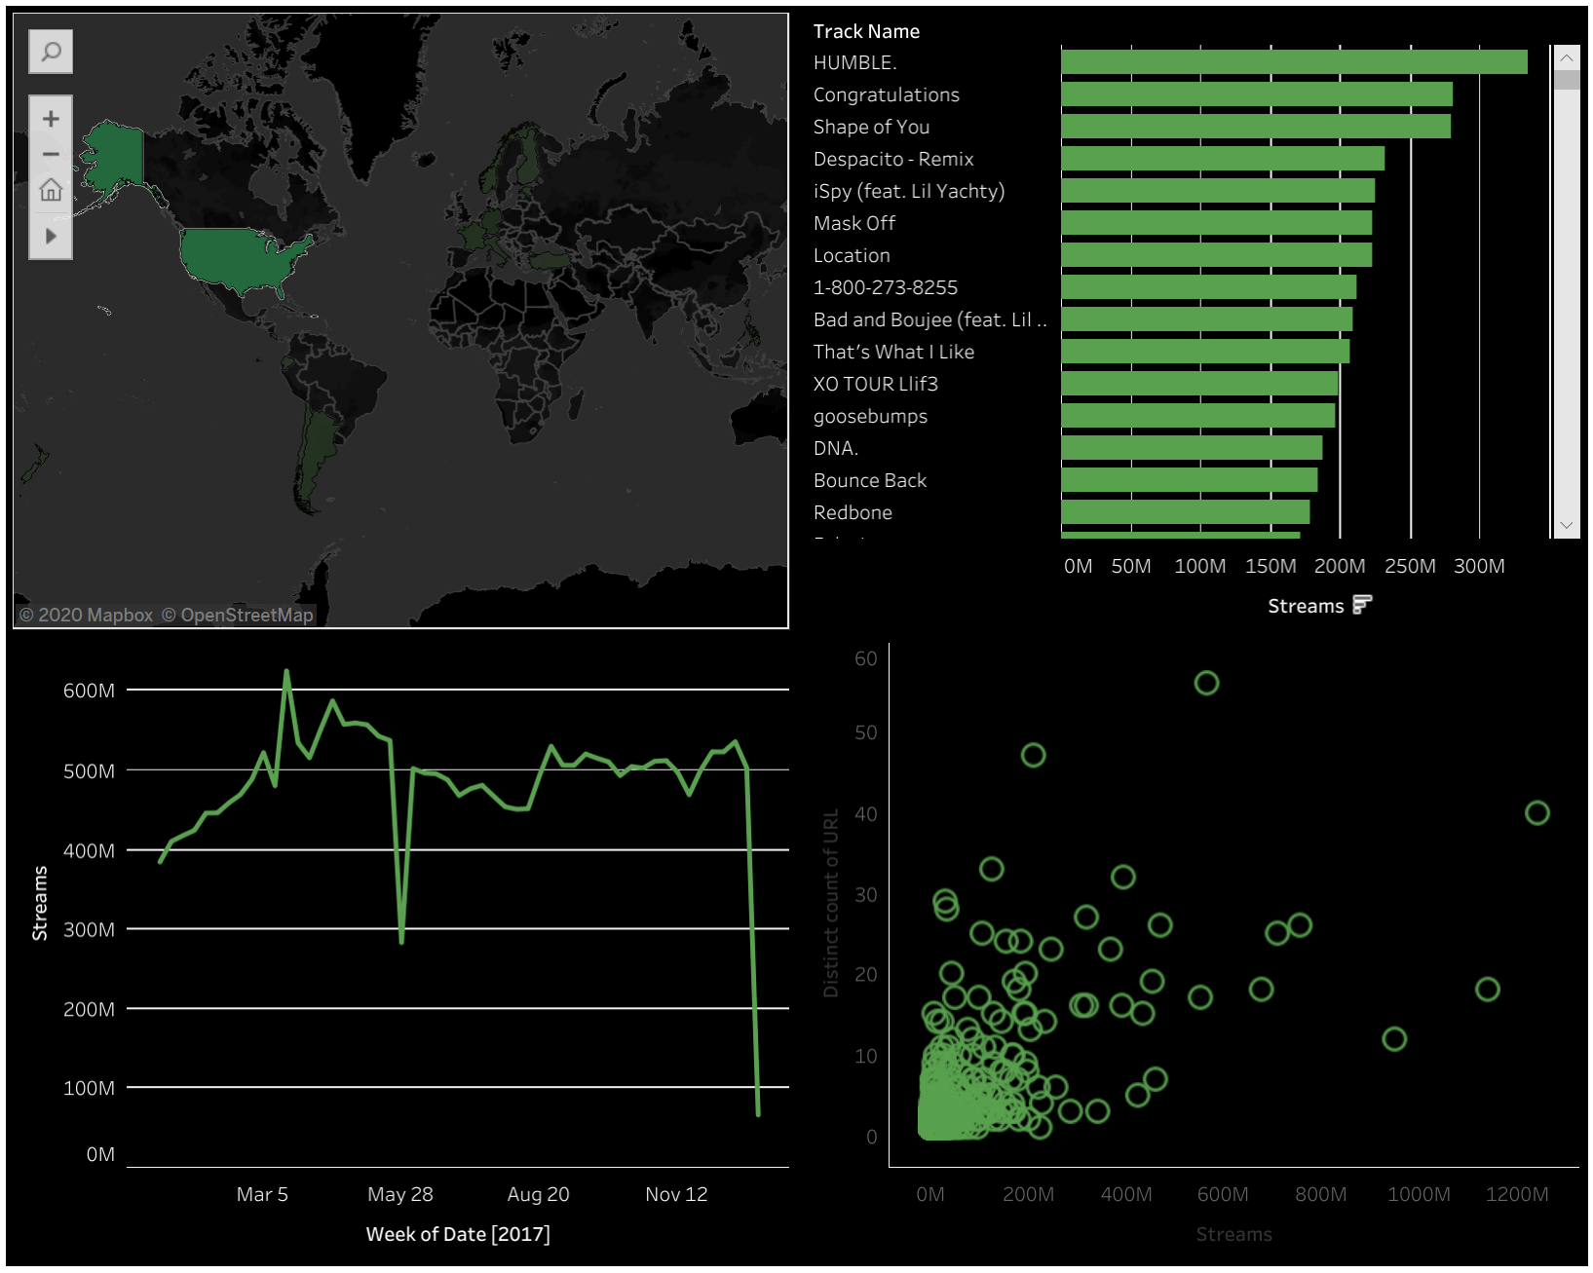
Tableau Dashboard

Slide 5


HOW CAN WE USE MACHINE LEARNING WITH SPOTIFY DATA?

Slide 6
QUESTION
CAN WE PREDICT A MOOD ACCORDING TO SONG FEATURES?

Slide 7
Machine Learning
Dataset
https://www.kaggle.com/edalrami/19000-spotify-songs

Slide 8
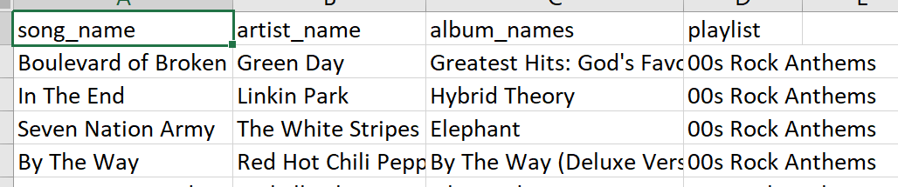
Machine Learning Data
song_data.csv
song_info.csv
https://www.kaggle.com/edalrami/19000-spotify-songs

Slide 9
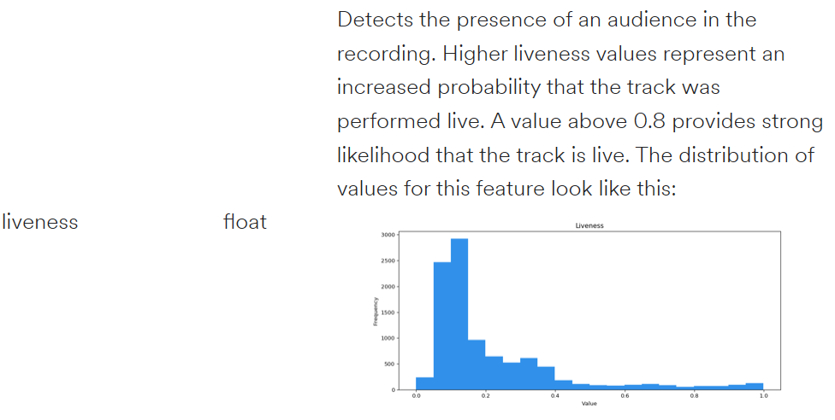
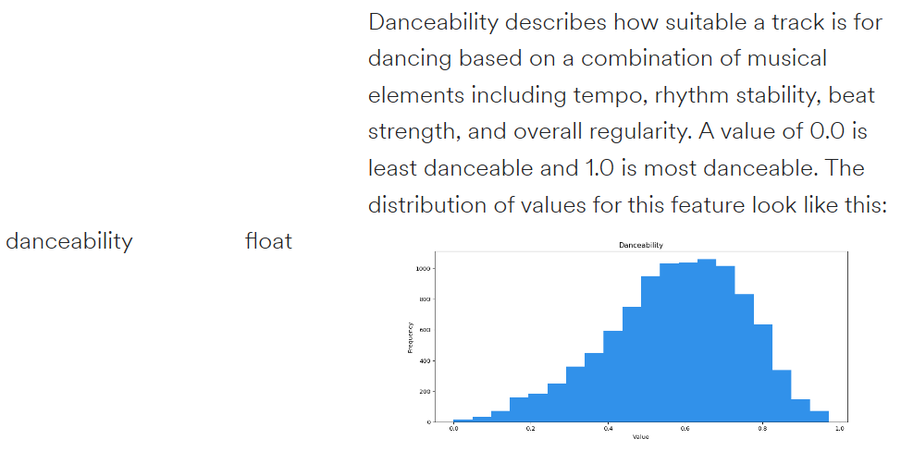
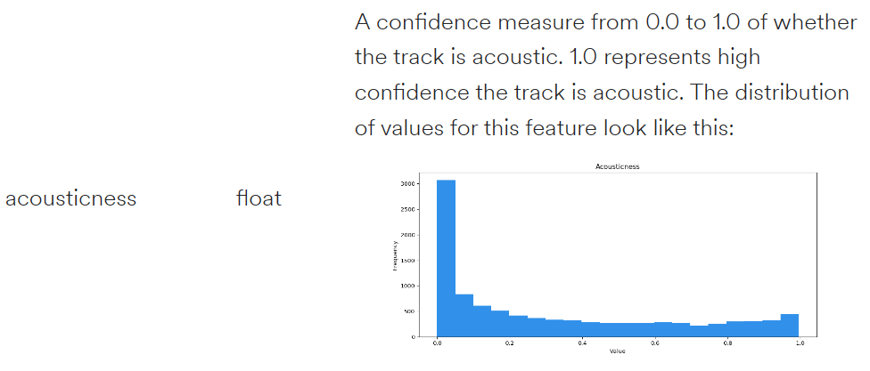
Machine Learning Understanding Data
https://developer.spotify.com/documentation/web-api/reference/tracks/get-audio-features/

Slide 10
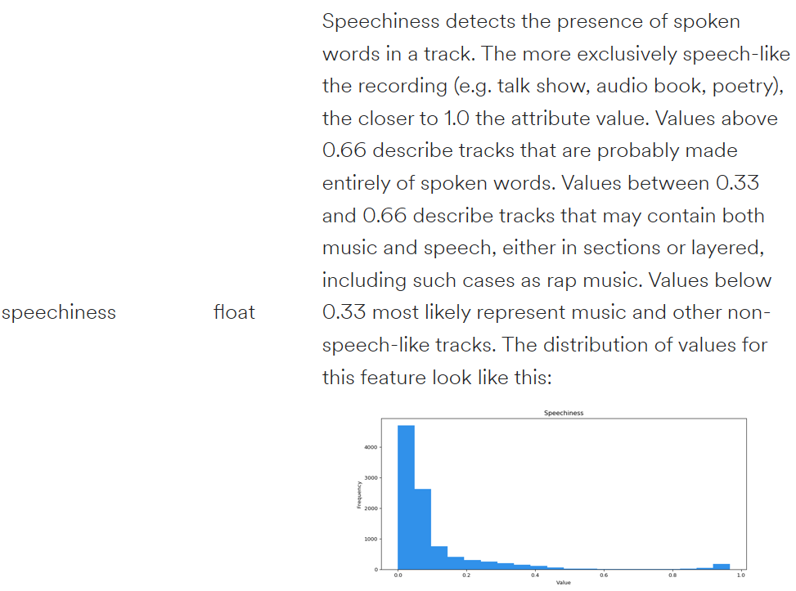
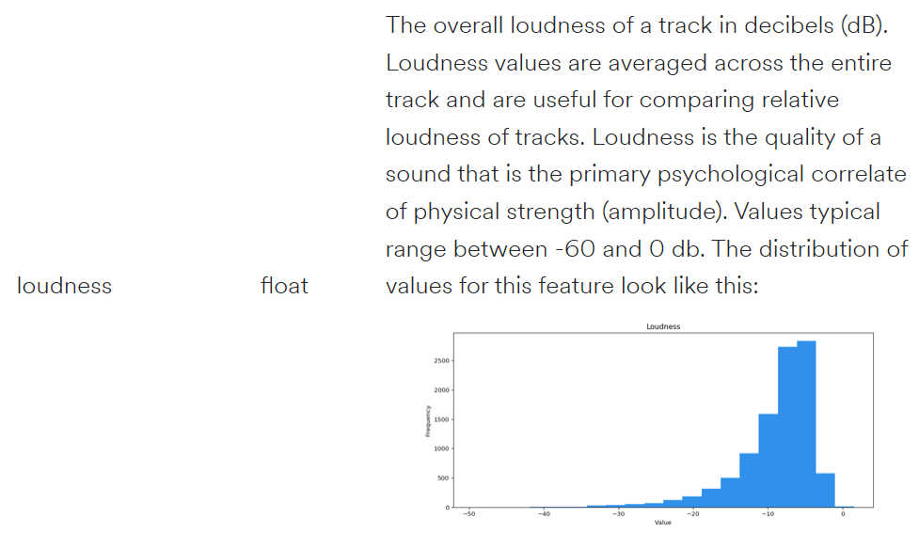
Machine Learning Understanding Data Continued
https://developer.spotify.com/documentation/web-api/reference/tracks/get-audio-features/

Slide 11
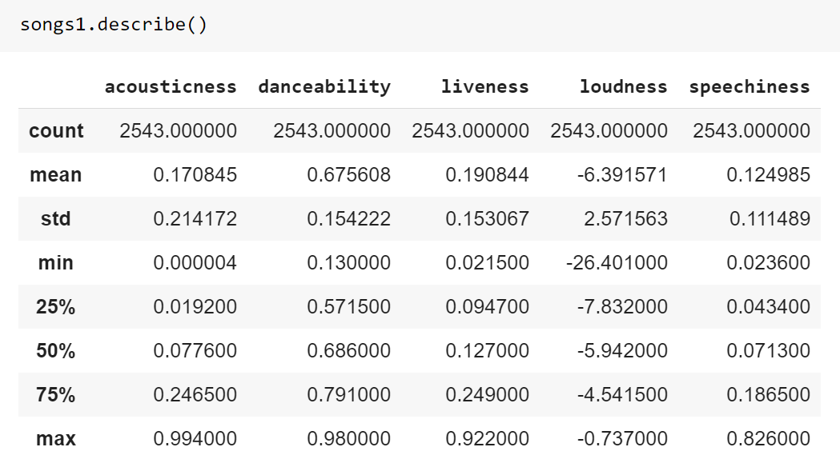
Machine Learning Pre-Processing

Slide 12
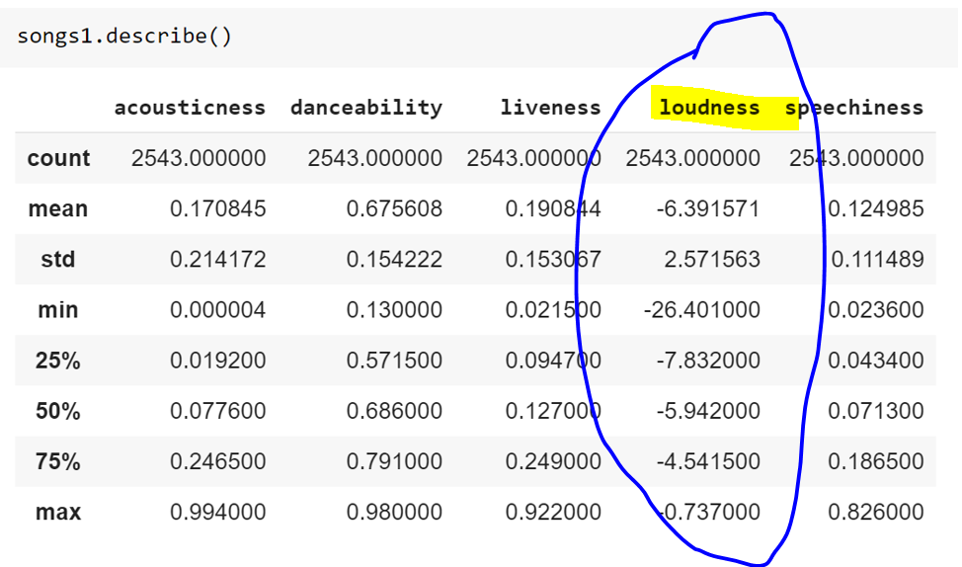
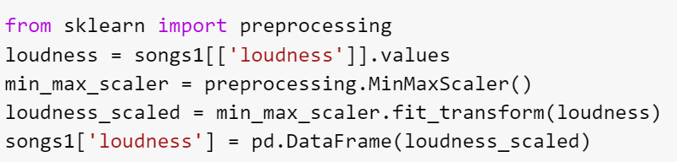
Machine Learning Pre-Processing – Scaling loudness

Slide 13
NEW QUESTION
CAN WE PREDICT A MOOD ACCORDING TO SONG FEATURES FROM PATRICKS PLAYLIST?

Slide 14
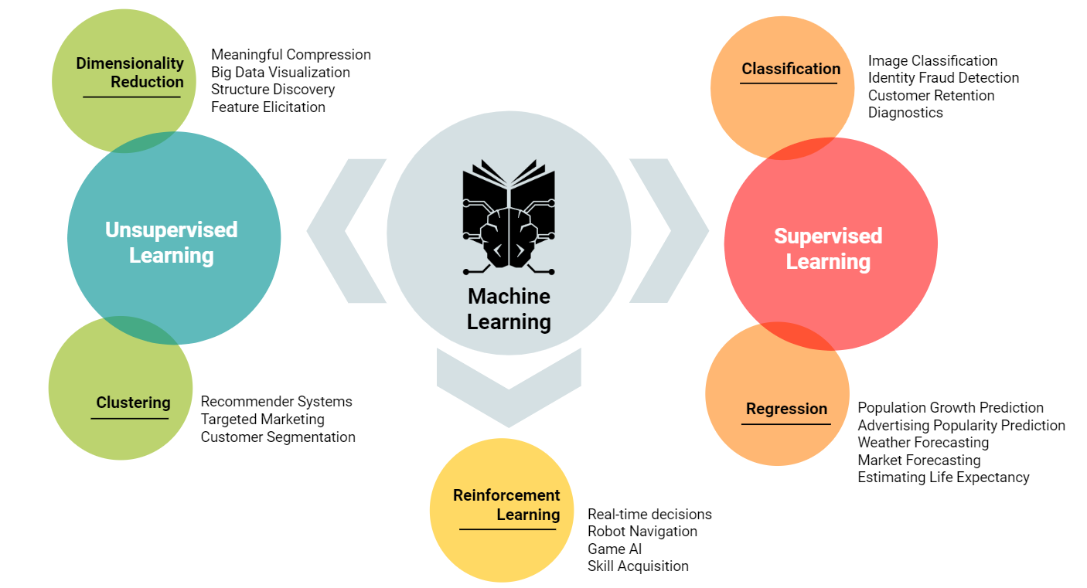
WHICH ONE DO WE USE?
AND THIS ONE
THIS ONE

Slide 15
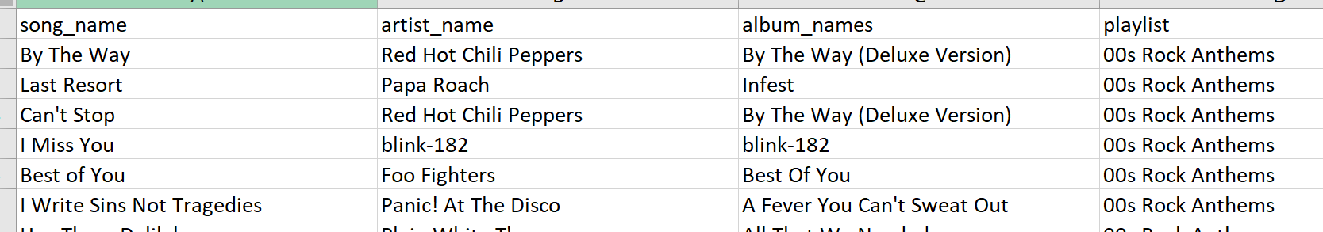
Machine Learning Added Data
song_info
song_data
Patrick_list

Slide 16
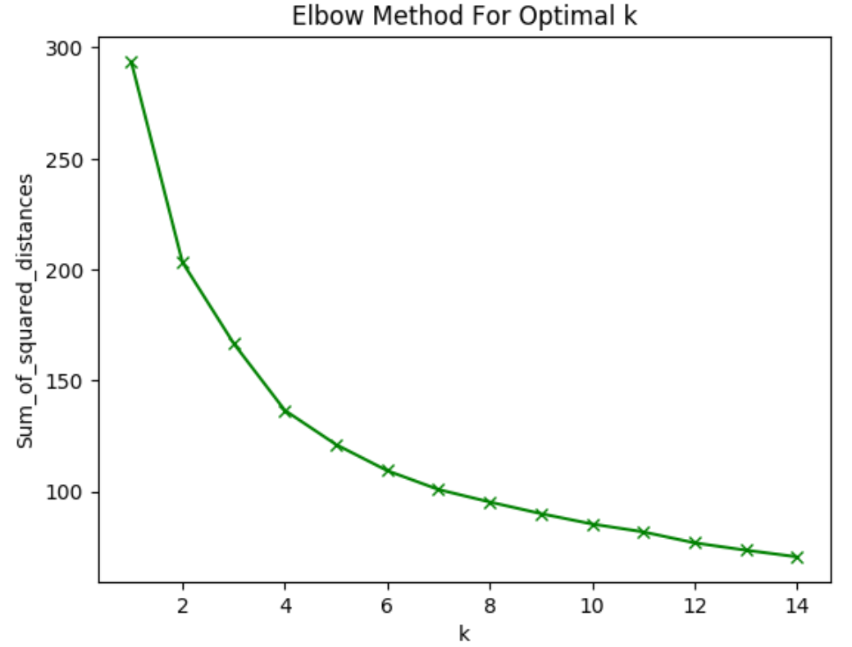
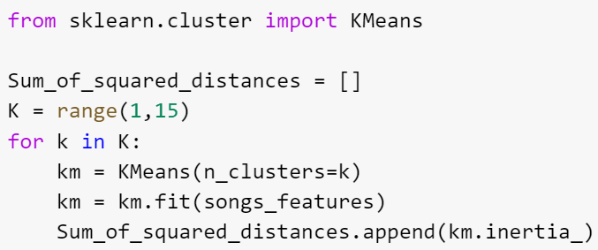
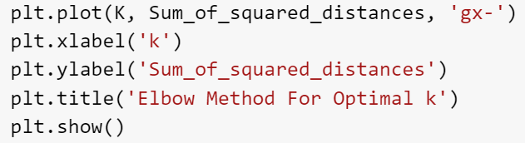
Machine Learning Kmeans clustering
Optimal k = 3 or 4

Slide 17
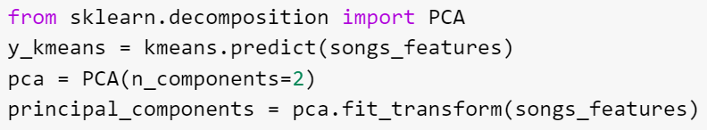
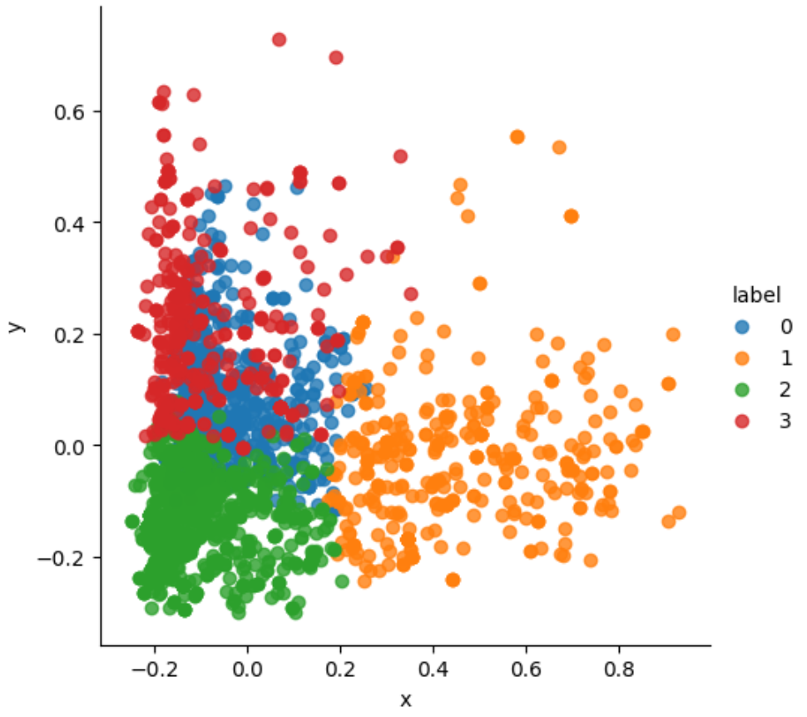
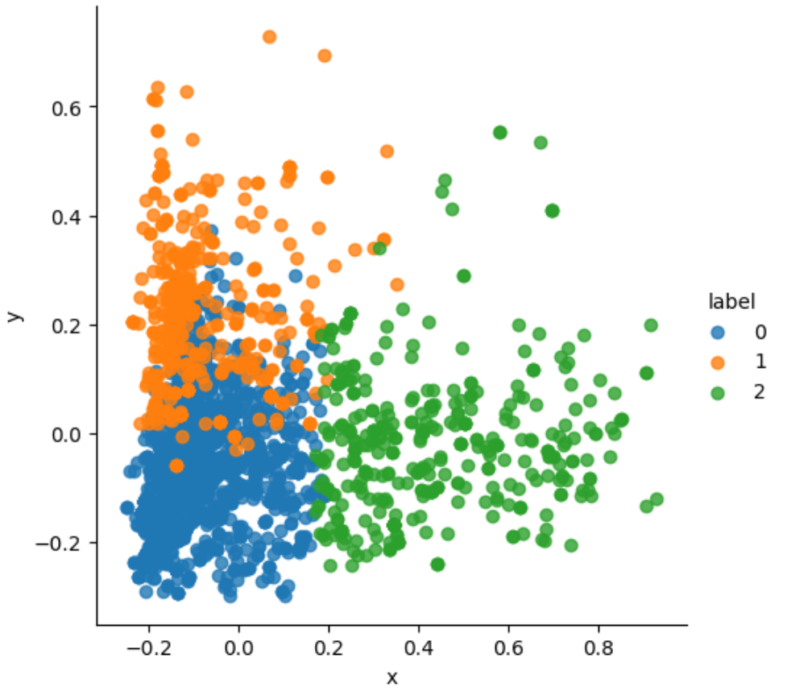
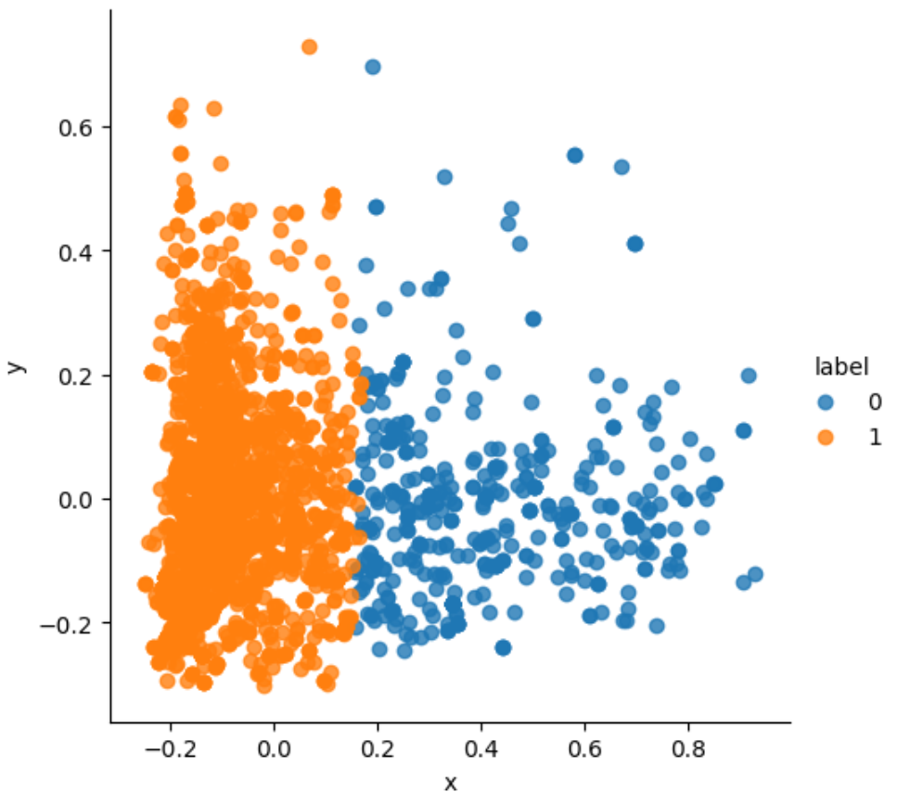
Machine Learning Kmeans clustering (n_cluster = 4, 3, and 2)
seaborn.scatterplot

Slide 18
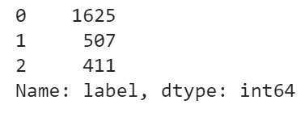
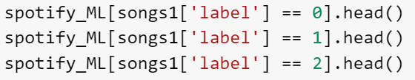
Machine Learning Cluster Values (n=3)

Slide 19
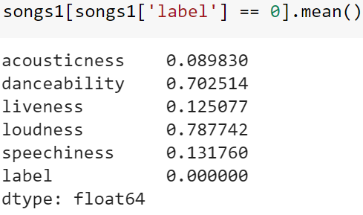
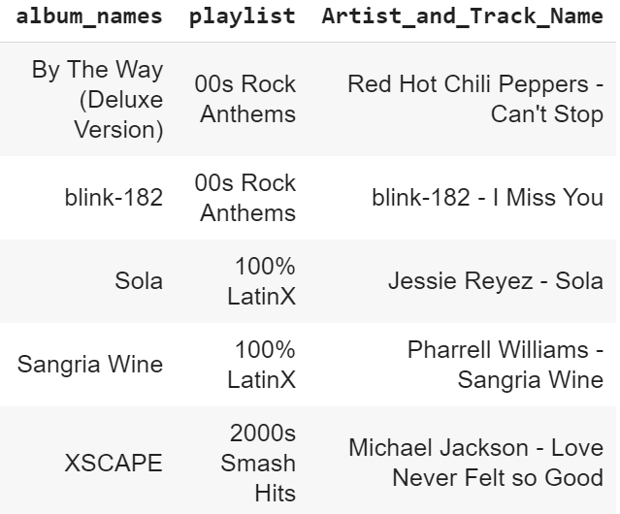
Machine Learning Checking Cluster Values [0]
1625 songs | danceability and loudness are high
[0] = Chill and Dance/Energetic

Slide 20
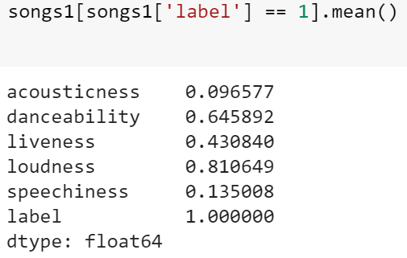
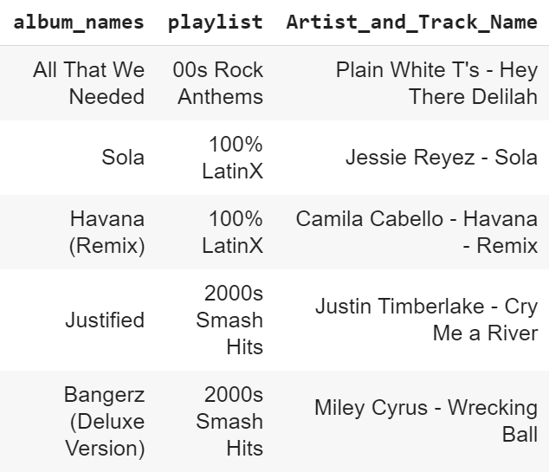
Machine Learning Checking Cluster Values [1]
507 songs | loudness is high and liveness is high
[1] = Chill and Sing/Aspiring Singer

Slide 21
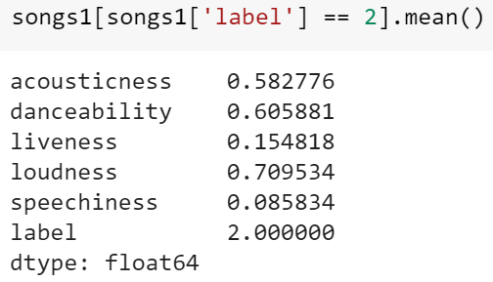
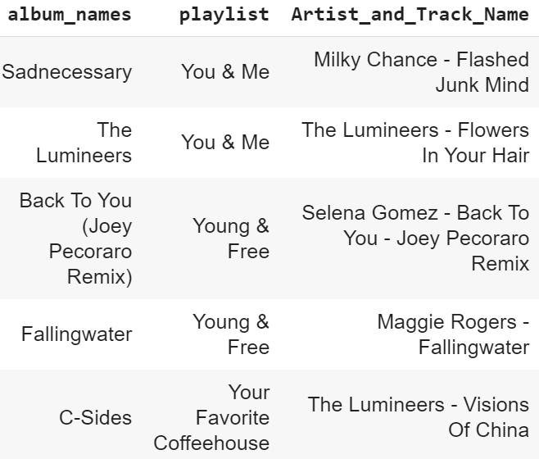
Machine Learning Checking Cluster Values [2]
411 songs | loudness and speechiness are lower
[2] = Chill and be chilled/Relaxed

Slide 22
WHERE ARE WE NOW?
HERE

Slide 23
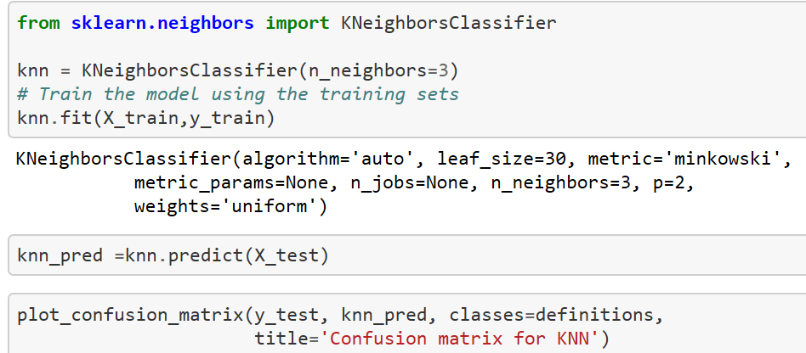
Machine Learning Train and Test using K-Nearest Neighbor
Split dataset into training and test set (70:30) and trained on KNN Classifier model

Slide 24
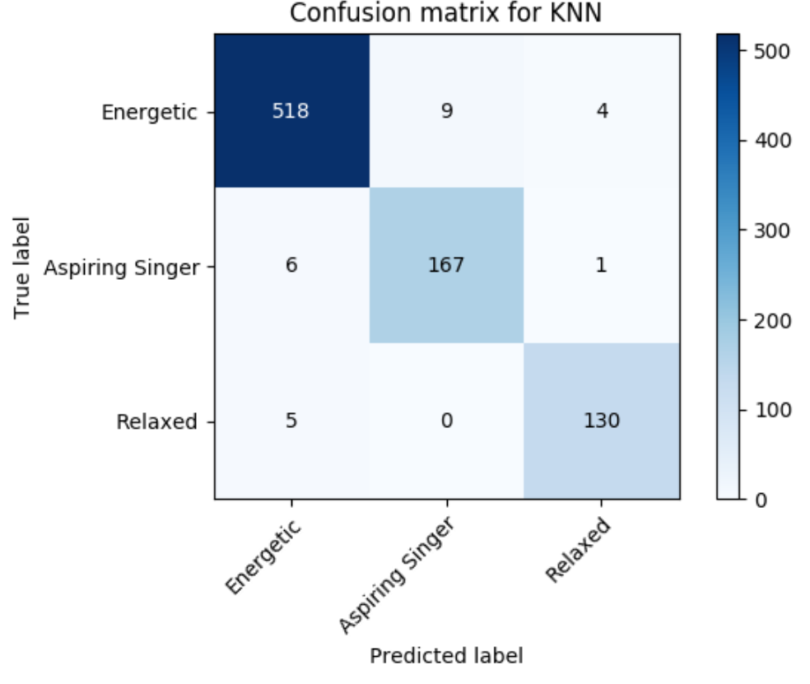
Machine Learning Confusion Matrix
Analysis
Not a perfect confusion matrix
25 False positives
Relaxed had highest prediction accuracy

Slide 25
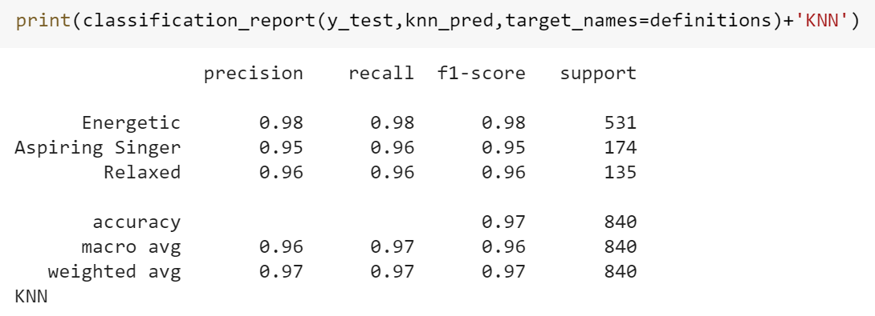
Machine Learning Classification Report

Slide 26
WHATS THE QUESTION AGAIN?
CAN WE PREDICT A MOOD ACCORDING TO SONG FEATURES FROM PATRICKS PLAYLIST?
Patrick says - YES but only because its his playlist

Slide 27
Fun Facts
Patrick is a song skipper
Does not enjoy Country Music or Jazz…most skipped songs
His all-time favorite song is “Hypnotize” by Biggie
He might want to expand his music taste and have more moods ☺

Slide 28
Conclusion
Had fun exploring my playlist
You can do it too!
Would be fun to see if it could be used to recommend future songs
CONGRATULATIONS CLASSMATES

